Slide 1
Transformers and Masked Language Models
CS 162: Natural Language Processing
Nanyun (Violet) Peng
Course website: https://vnpeng.net/cs162_win24.html
syllabus,
announcements,
slides,
homeworks
1

Slide 2
Important Announcement
Midterm exam will be next Monday, 2/12, in class.
A practice midterm will be released this month.
Assignment 1 answer keys has been released today.
You CAN bring a calculator for the exam.

Slide 3
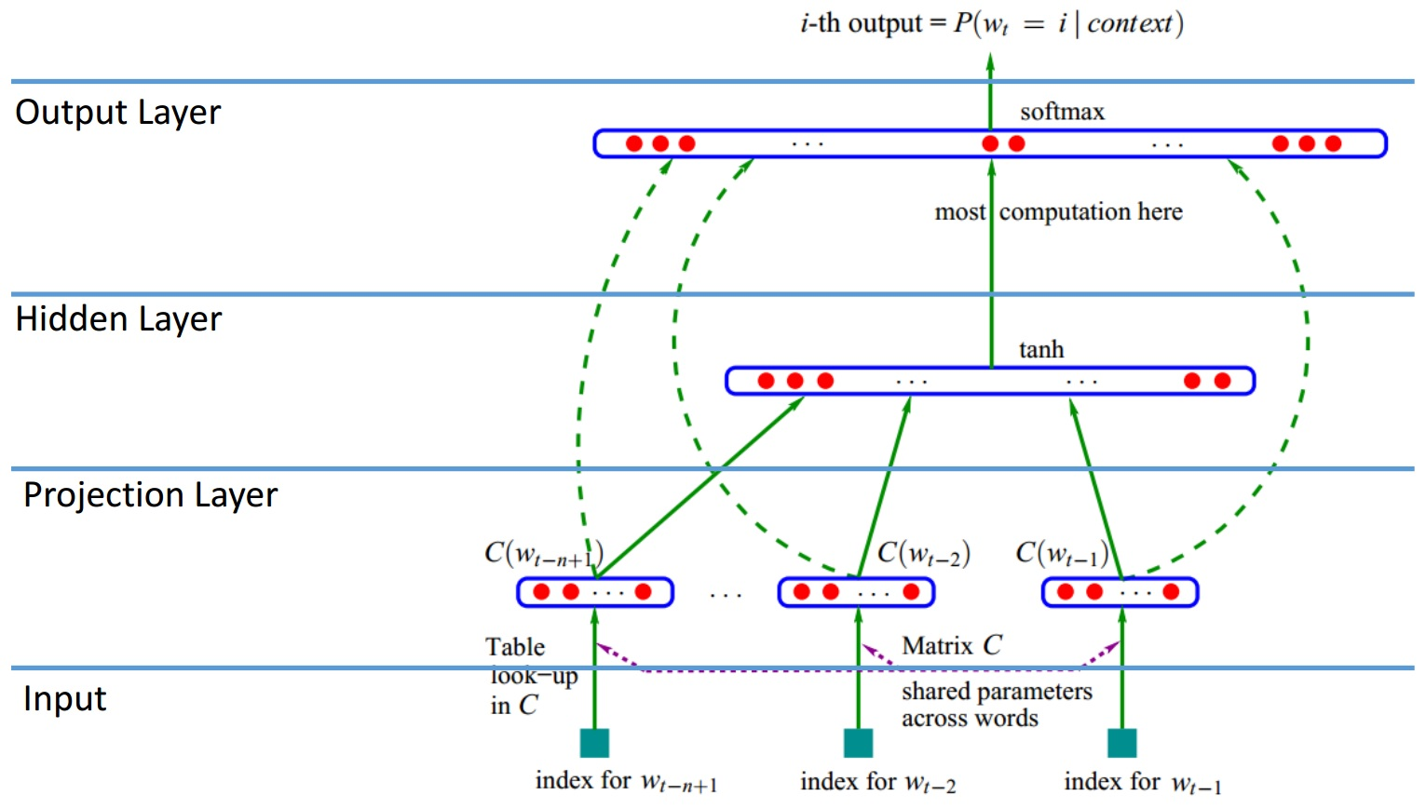
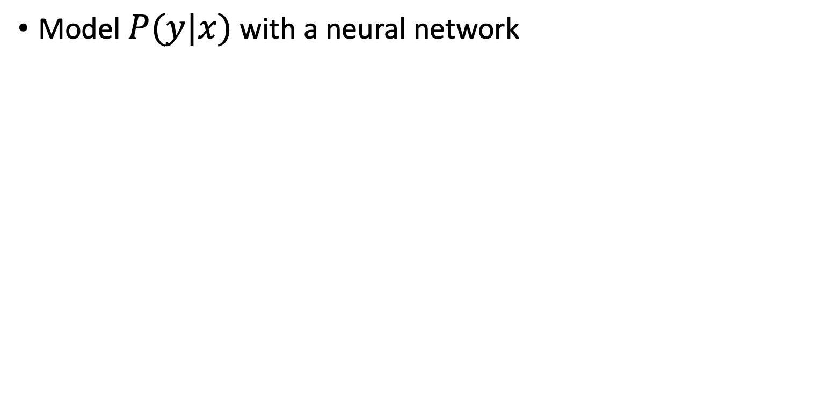
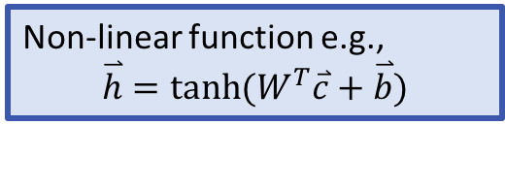
Feedforward Neural language model
Model $P(y|x)$ with a neural network
Y. Bengio et al., JMLR’03
Obtain (y|x) by performing non-linear projection and softmax
Non-linear function e.g.,
$$\overset{⃑}{h}=tanh⁡(W^{T}\overset{⃑}{c}+\overset{⃑}{b})$$
Concatenate projected vectors to get multi-word contexts.
Word representations to project inputs into low-dimentional vectors

Slide 4
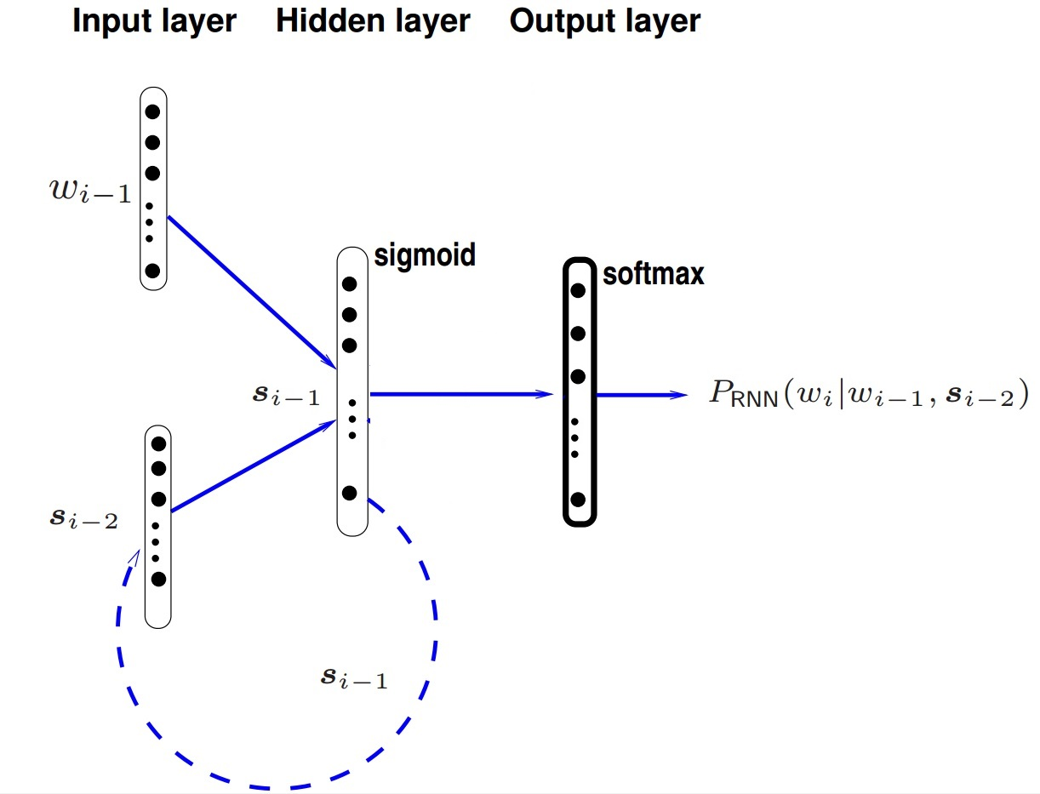
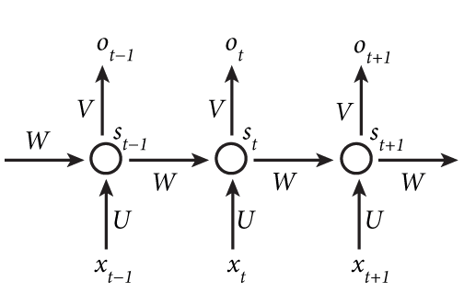
RNN Language Model
Notes:
In theory, can remember arbitrary length history;
In practice, will decide based on the input data.

Slide 5
Limitation of RNNs/LSTMs
The sequential nature of RNNs/LSTMs limit constrain the ability to parallelize computation
The vanishing gradient problem is still an issue even for LSTMs (models tend to forget the information that are further away)
The Transformer model – Attention is all you need!
Notes:
Paradigm shift to replace recurrent neural network units with transformers

Slide 6
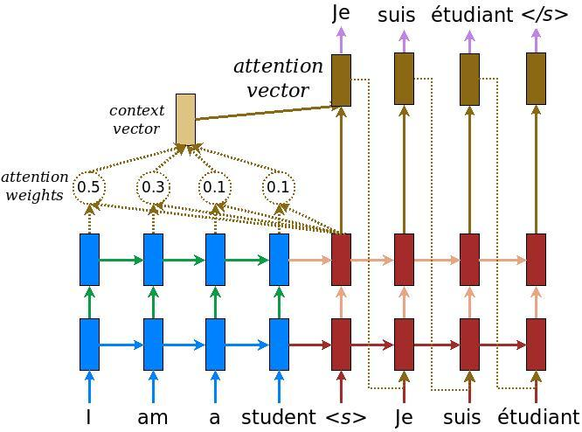
Attention Mechanism

Slide 7
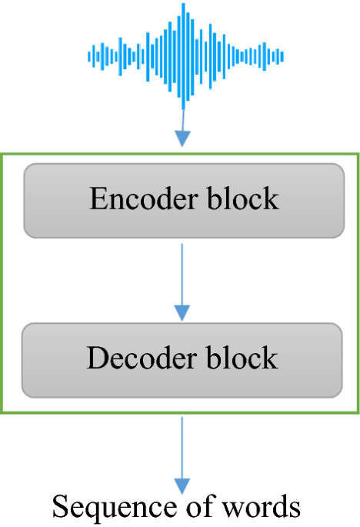
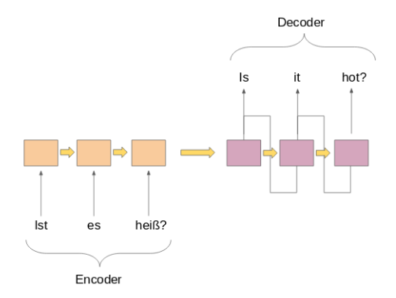
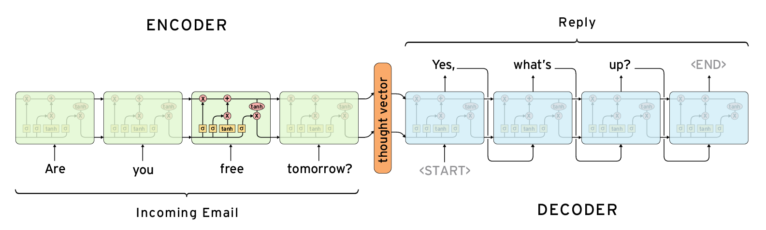
Background: Sequence-to-sequence Models
The sequence-to-sequence setup:
A sequence x₁, x₂, … x_{n} goes in
A different sequence y₁, y₂, … y_{m} comes out. E.g. --
Speech recognition: Speech in, word sequence out
Machine translation: Word sequence in, word sequence out
Dialog : User statement in, system response out
…
Violet is teaching
query

Slide 8
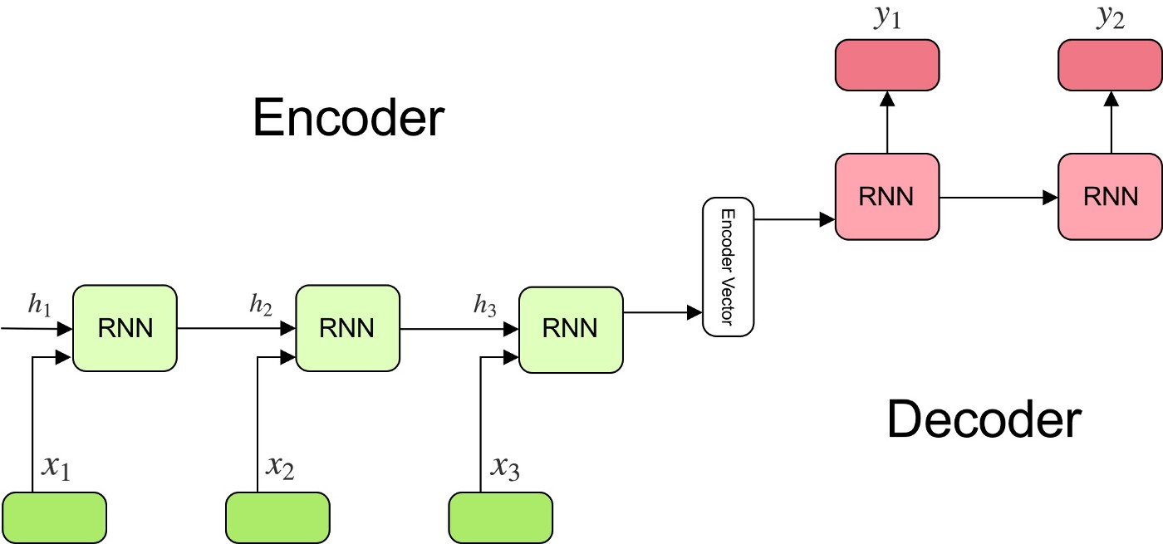



Background: Sequence-to-sequence Models

Slide 9
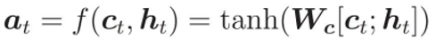
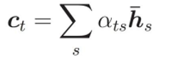
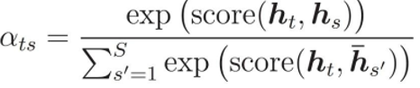
Seq2Seq with Attention

Slide 10
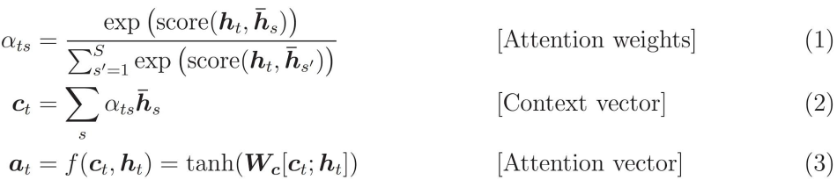
Attention Mechanism
Models tend to forget the information that are further away.
Can we reinforce the “memory”?
Using a_{t} instead of h_{t} to make predictions.

Slide 11

Attention is All You Need (?)
Transformers
A model architecture eschewing recurrence and instead relying entirely on an attention mechanism to draw global dependencies between input and output
Easier to parallelize the computation.
Most of the following visualizations are from http://jalammar.github.io/illustrated-transformer/

Slide 12

Stacks of encoders and decoders
Notes:
Encoder and decoder component is a stack of encoders and decoders, by default 6
Each encoder or decoder is identical in structure, but have independent weights

Slide 13

Structures of each
encoder and decoder
Notes:
Self-attention layer: helps the encoder look at other words in the input sentences as it encodes a specific word
In decoder: encoder-decoder attention: helps the decoder focus on relevant parts of the input sentences (similar to attention in seq2seq models)
> Next: left first focus on the encoder side, and have a look at what’s inside each of the green box

Slide 14
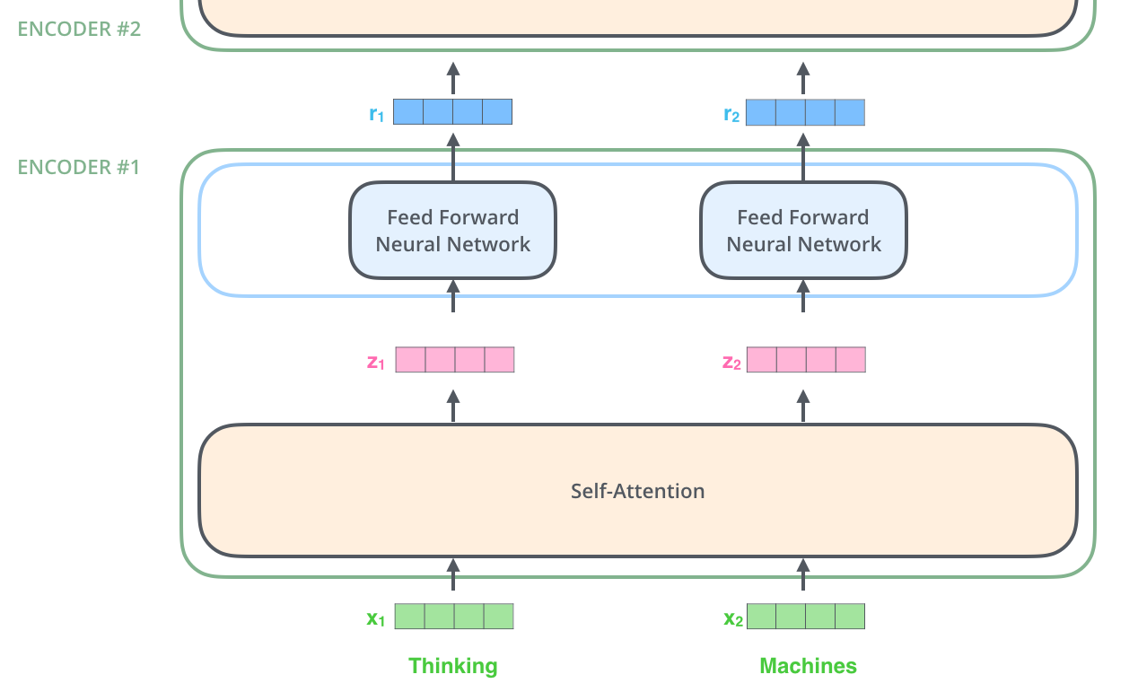
Notes:
First got word embeddings, only happens in the bottom-most encoder
In the bottom encoder that would be the word embeddings, but in other encoders, it would be the output of the encoder that’s directly below
In each encoder, data flows through each of the two sub-layers of the encoder
Word in each position flows through its own path in the encoder
But dependencies between these paths in the self-attention layer
FFNN
Two linear transformation, one ReLU
> Next: What’s self-attention

Slide 15

Self-Attention
Self-attention allows it to look at other positions in the input sequence for clues that can help lead to a better encoding for this word.
https://nlp.seas.harvard.edu/2018/04/03/attention.html
Notes:
Example
Which word “it” refer to, the street or the animal?
Like RNN, we can maintain hidden state to incorporate previous words representation to learn about context
Self-attention is the Transformer’s way to understand the context
Self-attention is between
Target word and input sequence

Slide 16

Self-Attention in Detail
Step 1: create three vectors
They are the query, key and value vectors.
What do these vectors encapsulate?
Notes:
Create three vectors based on the input vectors: queries, keys and values
There are three independent matrices W^Q, W^K, W^V, trained during the training process
Get vectors by multiplying the embedding by three matrices
Finally, for each word, we have one query, one key, and one value project.

Slide 17

Self-Attention in Detail
Step 2: calculate the attention
Attention: how much focus to place on other parts of the input sentence
The first word will “query” each other word and based on their keys to decide its attention on the words.
How many scores do we need to compute?

Slide 18
Self-Attention in Detail
Step 3-4: scale and softmax
Scale normalize w.r.t. the query/key vectors dimension.
What’s the effect of this scaling?
Softmax gives us weights (attention) on the values.
Notes:
Divide the scores by 8 (the square root of the dimension of the key vectors used in the paper – 64)
Leads to having more stable gradients
Softmax normalizes the scores so they’re all positive and add up to 1.
How much each word will be expressed at this position

Slide 19
Self-Attention in Detail
Step 5: Multiply each value vector by the attention score
Focus on the words we want to attend on (high attention weights), and ignore irrelevant words (low attention weights)
Step 6: sum up the weighted value vectors
Notes:
Z_1 is a better version of this word embedding, it calculates how much each other word values it and then creates a better version of itself that represents this valuation

Slide 20
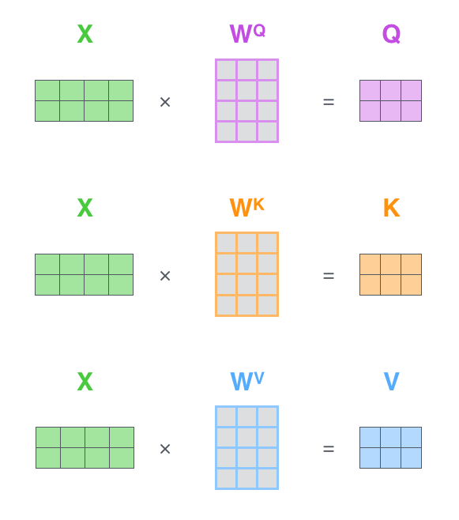

Self-Attention Implementation
Packing embeddings into matrix
Each row in the X matrix corresponds to a word in the input sentence

Slide 21
What do we have now?
After this self-attention layer

Slide 22
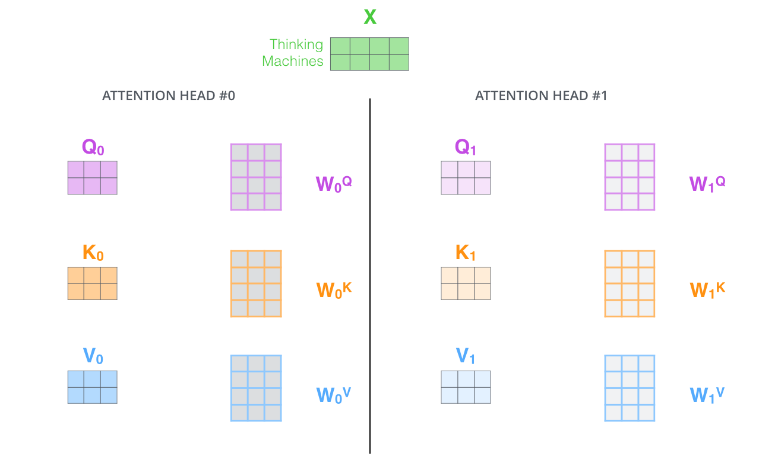
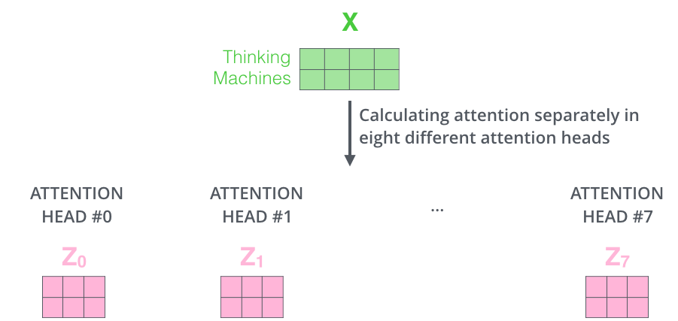
Single-head ->Multi-head Attention
Two benefits
Expands the model’s ability to focus on different positions
E.g. coordinate different perspectives such as semantic and syntactic
Gives the attention layer multiple “representation subspaces”

Slide 23
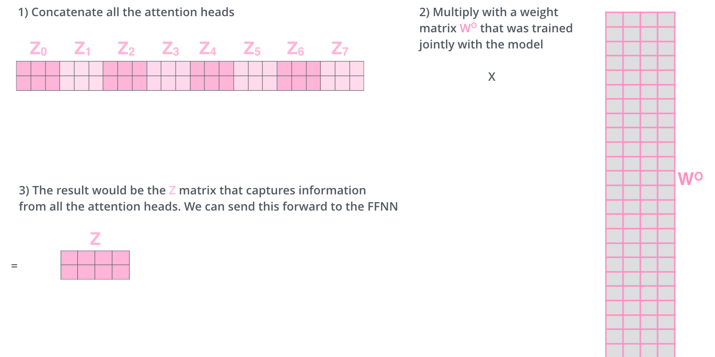
Single-head ->Multi-head Attention
Now we have 8 attention matrices, but we only expect one matrix to pass to the feed-forward neural network
Notes:
Concat the matrices then multiple them by an additional weights matrix W^O

Slide 24

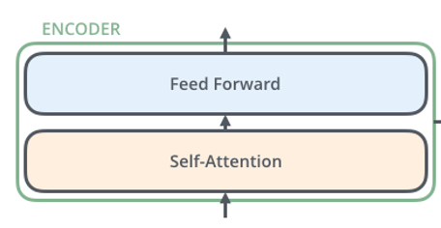
Notes:
Parameters: all W matrices

Slide 25
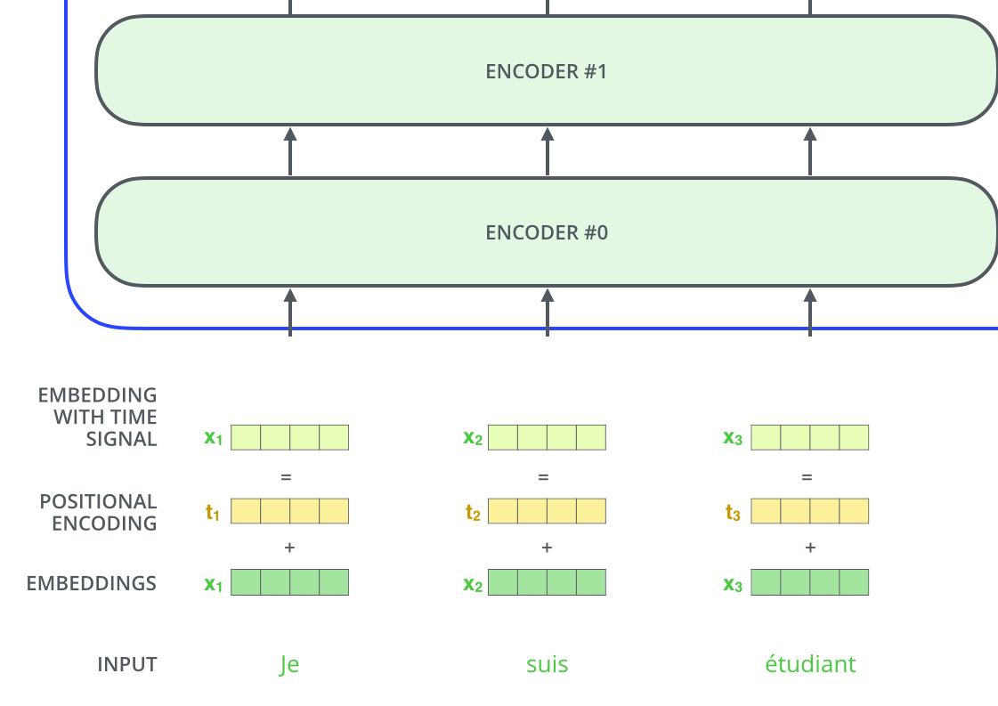
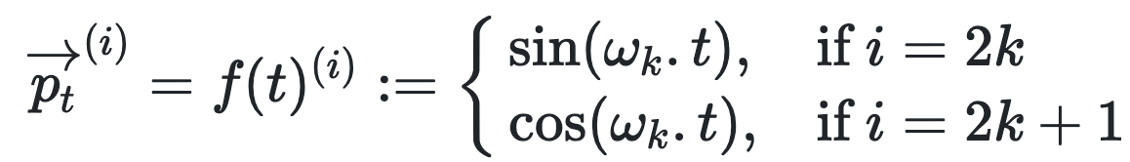
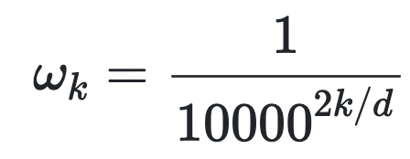
Positional Encoding t is position, i is dimension
Notes:
Account for the order of the words in the input sequence
No recurrence and no convolution
Adds a vector to each input embedding
Heuristic function

Slide 26

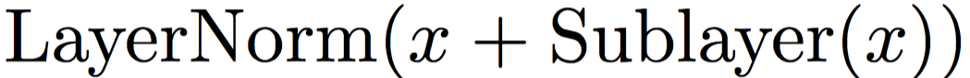
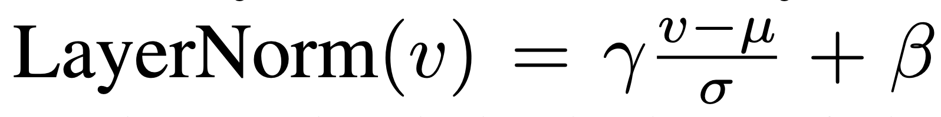
Residual Connections and Layer Norm
Issue of information loss -- Self-attention can decide not to attend to itself
-> Add input back again in each sublayer!
µ, σ are the mean and standard deviation of the elements in v. Scale γ and bias vector β are parameters.
Notes:
Employs residual connection around each of the two sub-layers, followed by layer normalization
Layer norm: modifies each item by subtracting the mean and divided by the standard deviation over the vector
often helps to speed up and stabilize the learning process

Slide 27
Encoders → Decoders

Slide 28

Notes:
The encoder start by processing the input sequence
Output of the top encoder is then transformed into a set of attention vectors K and V
These are to be used by each decoder in its “encoder-decoder attention” layer which helps the decoder focus on appropriate places in the input sequence

Slide 29

Notes:
The step repeat until a special EOS token is predicted.
The output of each step is fed to the bottom encoder in the next time step, and the decoders bubble up their decoding results just like the encoders did

Slide 30
Summary
We talked about transformer encoders (decoders are slight variations of the encoders to consider the cross-attention and the unidirectional nature of the decoding process.
The transformer is the first model that uses only attention as its underlying mechanism.
It achieved best performance on machine translation and can be trained much faster than convolutional or recurrent NNs.
It is the dominant architecture for NLP models nowadays and the backbone for large pre-trained language models.

